Slide 1
CHAPTER FIVE - “and it was FUN FUN FUN when we were hitching…”
After reading through all the serious stuff we thought the next few neat pages would help chill you out. You’ll find a whole host of things to keep you amused through all of those dark hitching moments you may find yourself in this week.
Never has so much fun been packed into so few pages. ☺

Slide 2

Cryptic Crossword – BUMMIT Style
DOWN
Ljubljana is twinned with ... in China.
Bummit is a sub-committee of ...
EU HQ resides here.
Colour of RAG.
Bummit went here last year.
Baby and Big Bummit 2011 charity.
Translated to English Malopolskie means...
Currency in Poland.
ACROSS
Number of years Bummit has been running.
Using a part of your body to get a lift.
You must call this EVERYDAY!
Refreshing Little Lifts
13. Your current guide to life.
Number of members on the Bummit committee.
Fire fighting charity.
Similar to the rag muffins (but better).
Gives you wings

Slide 3
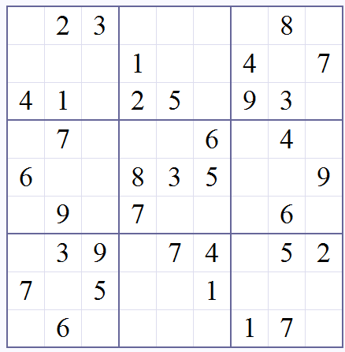
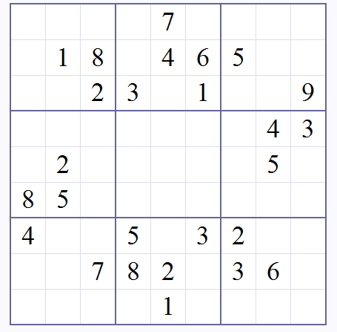
Coffee Break SUDOKU
hitching
If you’re feeling a bit low and want to cheer yourself up then attempt this mildly easy puzzle...
Or if you think you’re a Sudoku god give this one a try. Warning: BUMMIT accepts no responsibility for your actions if you get so pissed off with this puzzle that you throw your bible out the car window along with your burrito and hit Jack Black on a motorbike.

Slide 4
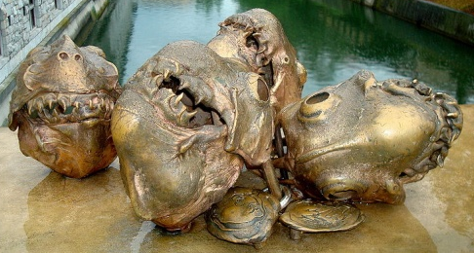
The Bummit Awards!
The Oscars? What are they?
The Baftas? What a load of rubbish.
All other award ceremonies have a shadow cast over them by the sheer brilliance of the BUMMIT awards. Taking place in venues across Sheffield which the paparazzi have never even heard of the winners of these prestigious awards have gone on to gain not even a hint of worldwide stardom. But don’t let that stop you attempting to become part of this group of nobodies whom we will neither remember or care about.
Main Categories:
Best Blag
Best story told to gain a lift
Least money spent
Most inventive comedy prop / fancy dress
Most Counties travelled through
Most / Fewest lifts
Photo Categories:
By now, I’m sure you’re all delighted with the beautiful high-tech cameras us at Bummit HQ have landed you this year- that’s why we’re having a CANDID CAMERA COMPETITION! Applause.
Funniest road sign
Best Bums out photo
Best randomness in front of any landmark
Best Spelling of the word ‘BUM’ between you and your team
Most shifty/unattractive driver
Most pissed off official
Best foreign chav
Best Pic in front of this landmark:
All the prizes for the bummits will be handed out at the epic post BUMMIT social. This year its going to be huge.
Its one not to be missed.

Slide 5
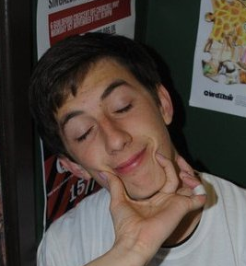
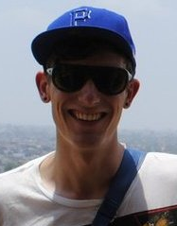
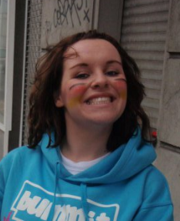
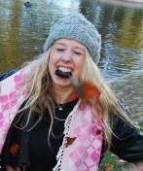
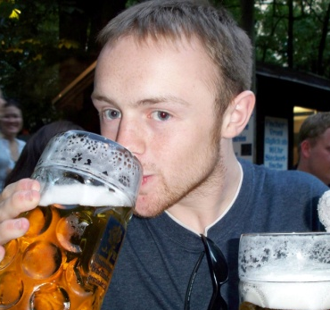
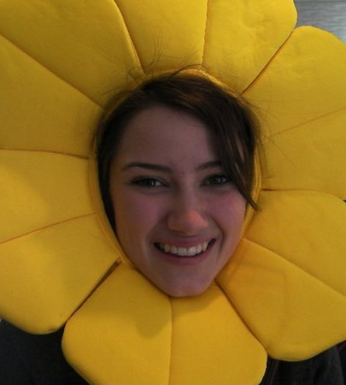
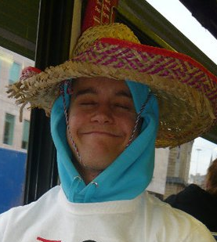
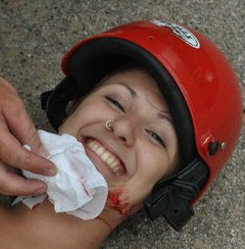
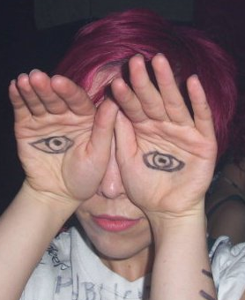
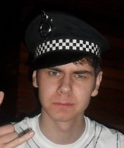
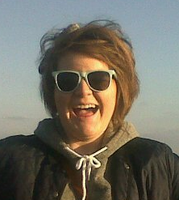
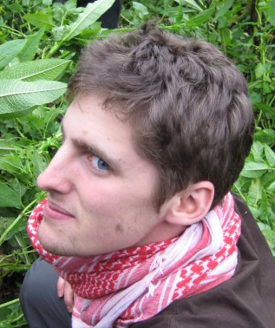
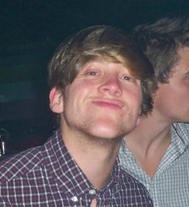
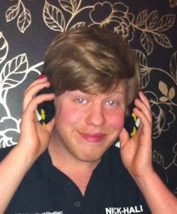
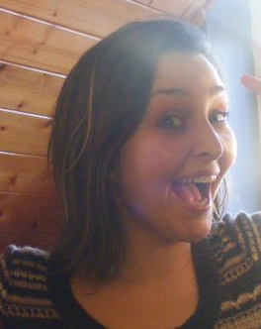
THE BUMMIT COMMITTEE 2011
All the nice folk at BUMMIT HQ who put this years event together:
Robert Hughes
Ryan Brewer
Angela Adams
Madeline Whitehead
Ian Morrisey
Chloé Brelsford
Tom Pindar
Cassie Wilkins
Lauren Kelly
Samuel Bale
Sarah Louise Hogg
Jamie Robins
And the most humongous thank you to Emma Damian-Grint who pulls all the strings behind the scenes ☺
Paul Taylor
Nick Hall
Want to be part of next years committee massive??
Look for the BUMMIT AGM after we’ve all recovered from our week of madness in Europe.
Your invite is in the post.

Slide 6
The Diary!
Day 1: Ready, steady, GO!…
Day 2: Have anything for breakfast that will give you the energy to hitch. Red bull or Ben and Jerrys always go down a treat.
Day 3: Get stuck miles from a public toilet and accept that not packing that loo roll before you left was a crap idea.
Day 4: Rave it up in Ljubljana!

Slide 7
The Diary!
Day Five: Try to make your hangover day more positive by blagging a train ride using crazy hand gestures.
Day Six: Convince all the locals you and the queen are bessie mates and you have been invited to the royal wedding.
Day Seven: Resort to pretending you’ve broken your leg to get those last few lifts speedily.
Day 8: Relax, you’ve made it to Krakow in one piece.
Best / Worst Memory:

